Slide 1
Clemenceau, the Vampire
Interpreting a cartoon

Slide 2
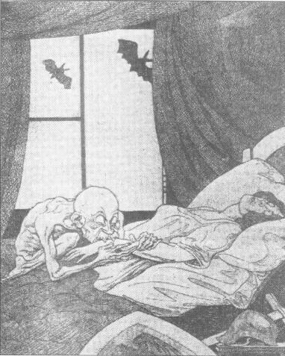
How do I interpret this cartoon?
Context – what was happening at the time?
Content – what is happening in the cartoon?
Comment – what is the meaning of the cartoon?

Slide 3
Context – what was happening at the time?
Germany had just been defeated in WWI.
The Treaty of Versailles was signed in1919.
It had been written by the ‘Big Three’ and imposed on Germany.
Clemenceau wanted to ruin Germany
The Treaty blamed Germany for the war
The Treaty made her pay ‘reparations’ for ALL the damage.
Germany lost lots of land.
Germany lost her armed forces.
The Germans hated the Treaty.

Slide 4
Content – what is happening in the picture?
A young girl, beautiful but poorly.
An evil-looking vampire...
… who is sucking the girl’s blood
Weapons laid aside.
Two bats outside the window – more vampires.
The window is open – the curtains are blowing.

Slide 5
Comment – what is the meaning of the picture?
Germany
Clemenceau
Taking reparations
Germany’s army had been disbanded by the Treaty of Versailles.
Britain and America
Germany is helpless to defend herself.
Two more bats
Window open
Vampire
Poorly girl
Sucking
blood
Discarded weapons

